Slide 1

Vet 4 Life
Brought to you by: The Fantastic Four
Vets don’t need to sweat

Slide 2
Agenda
What we can do for you
Concept
Supporting Technologies

Slide 3
Why Vet 4 Life?
Increase turn-over for reacclimating veterans
Simplify resource management for case managers
By allowing the website to minimize the resource list for each caller it allows the caseworker to work with more veterans and get information to veterans quicker
Facilitate resources between case managers and veterans

Slide 4


Concept
DIALOGFLOW ASKS FOR A NUMBER OF QUESTIONS
RUN KEYWORDS FROM ANSWERS THROUGH DATA BASE
RESOURCES CHOSEN BASED ON KEYWORDS
RESOURCES DISPLAYED FOR KEYWORDS ON CASE MANAGER’S SITE
CASE MANAGER REVIEWS RESOURCES

Slide 5
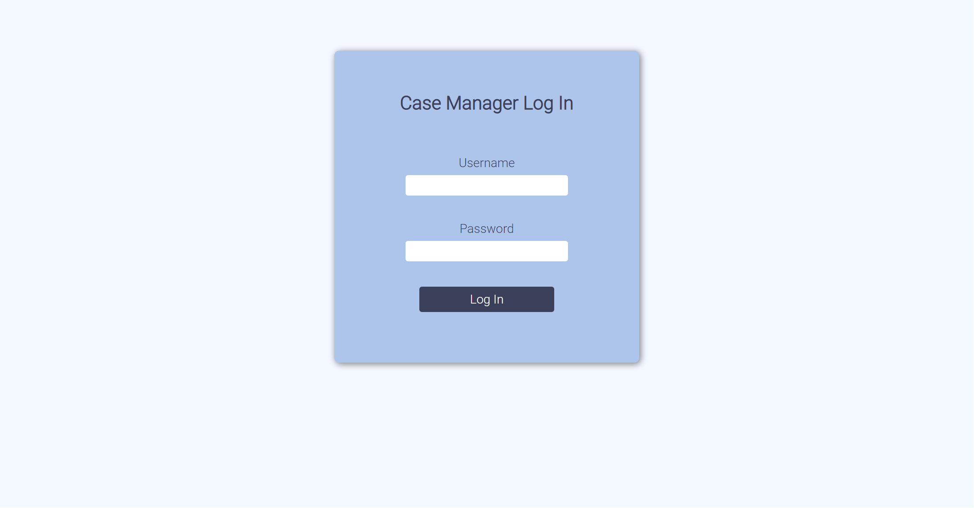
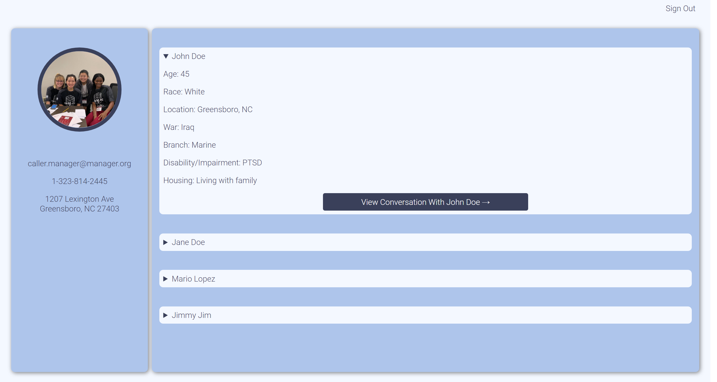
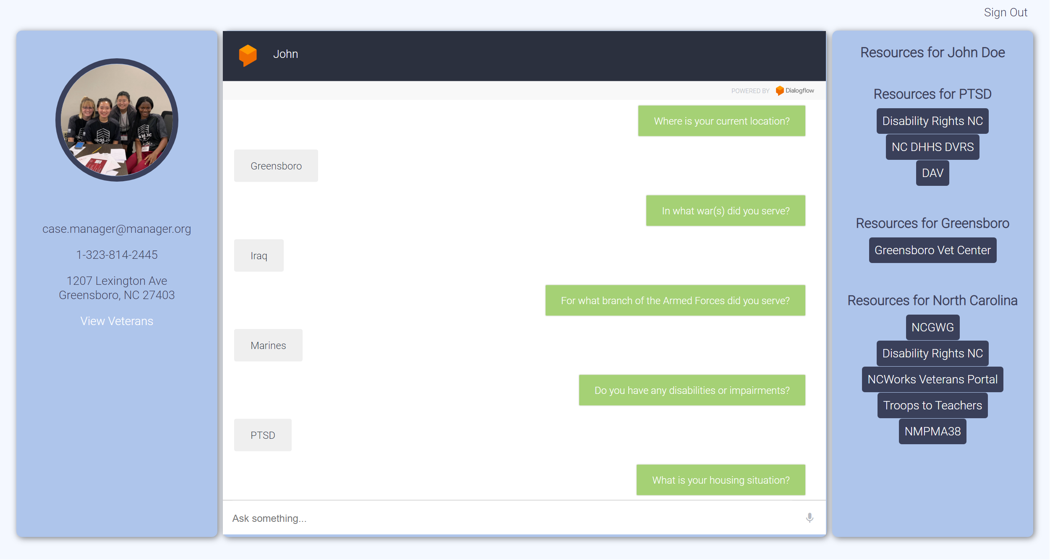

Slide 6
Supporting Technology
Dialogflow
Ease of access for veterans
With physical disabilities
With little access to technology
With little knowledge of websites & technologies
OpenCV
Facial recognition
Fast and easy way to pull up files for a given caller for appointments

Slide 7

In the Future
Different Languages
Access to Recording
Add Keyword Button
We want to implement our virtual assistant to be able to help veterans no matter what language they speak.
The case manager would be able to access the original recording of the call, in case there is some type of issue with the bot translating a veteran’s voice
Section on case manager’s workspace where they will be able to add key words to the database. This will allow the database to grow while also helping case managers identify more resources for a veteran’s specificities

Slide 8
In the Future Continued
After Resources are Given
Facial Recognition
Information on resources will be sent to caller along with a link to schedule a follow up appointment with a case manager if wanted
To speed up time bringing up a caller’s information for a follow up appointment
Way for caller’s information to be shared with resources so when they visit the veteran won’t need to worry about carrying paperwork

Slide 9

Thank you
Dale Shipman
Donald Rice
McKenzie Moize
Shanna Reece

